Slide 1

WELCOME
ERP TRAINING
October 23-30,2025

Slide 2

Introduction
Upgrade Schedule
Security Request & Signature Authorization Form
OKTA login and navigation
Hub Customization
Wild Card Searches
What’s coming
ERP support email erpsupport@franklincountyohio.gov

Slide 3
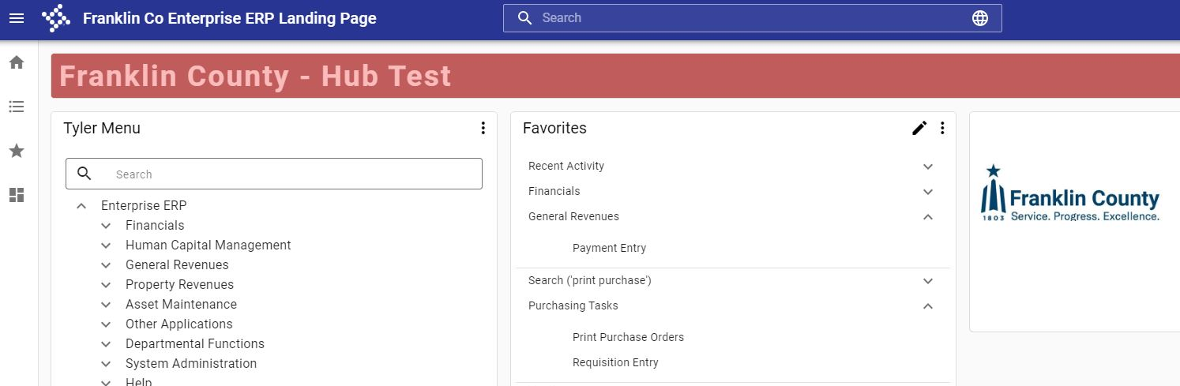
Upgrades
ERP (production) will upgrade from Version: 2024.2 to Version: 2024.5 the evening of October 31.
We plan to upgrade annually in the Fall; this will align with our workload and training schedule.
https://franklincountyoh-test.tylerhub.com/
Test is on upgraded version 2024.5
Notes:
In order for continued support from the vendor, we will need to update our ERP version regularly. Tyler Technologies has moved to a quarterly update cadence. We have decided to upgrade once a year in the fall to keep current.
Now that we are cloud hosted and on the web platform, updates will be easier to implement and should be easier for users to digest. Think of upgrades as “service packs”, a collection of bug fixes and enhancements. We will highlight major changes when noted.
We always encourage agencies to test upcoming versions themselves at https://franklincountyoh-test.tylerhub.com/ We test ourselves, but we may not always be aware of unique processes or reports that an agency relies upon.

Slide 4
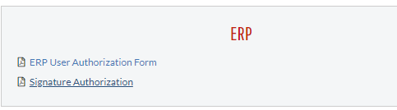
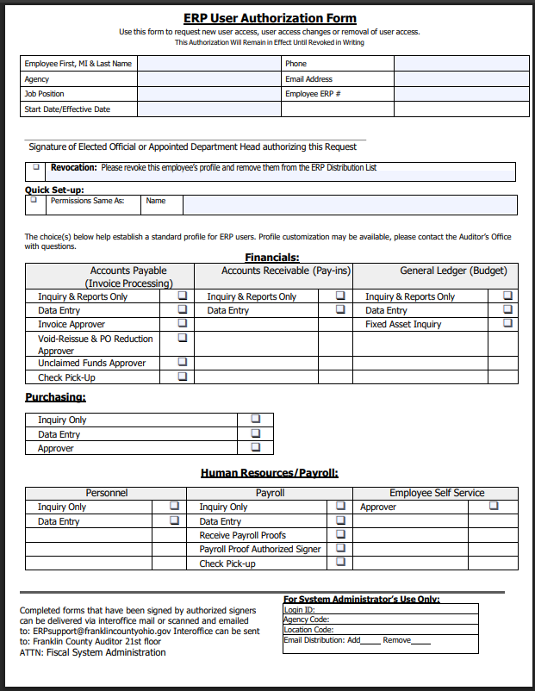
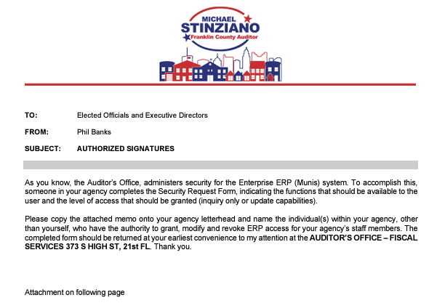
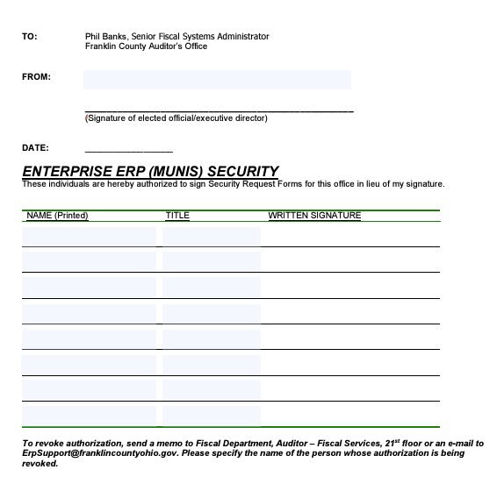
Security Request & Signature Authorization Form
Located in Form Center on Fiscally Speaking
https://www.franklincountyauditor.com/fiscal/fiscally-speaking/form-center

Slide 5
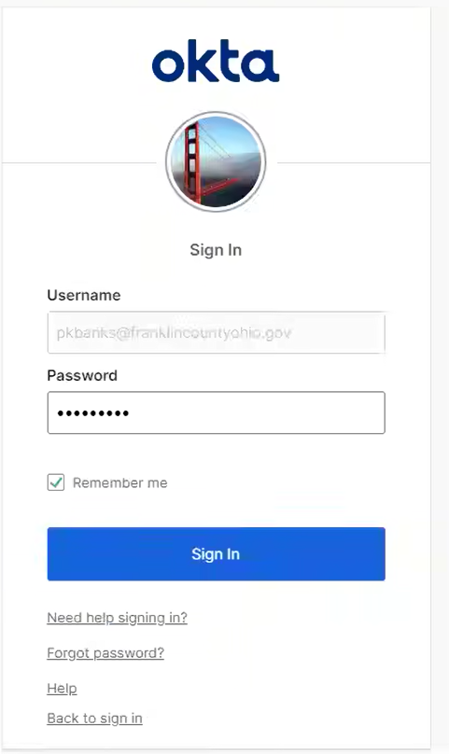
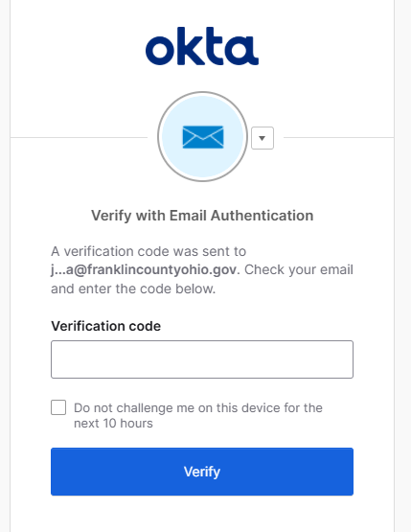
Login
Login process is unchanged. Use any browser (Chrome preferred) to : https://franklincountyoh.tylerhub.com/
Login will always require to Verify with Email Authentication. Okta , Titled: One-time verification code You will need to copy or note the 6 digit code for verification.
Forgot Password? Try Need help signing in link followed by forgot password link or you can email erpsupport@franklincountyohio.gov to request pw reset.
Notes:
Passwords expire after 120 days
Users get prompted 5 days before password expires
Password requires 8 characters including lowercase, uppercase, number, symbol and no part of first or last name.

Slide 6
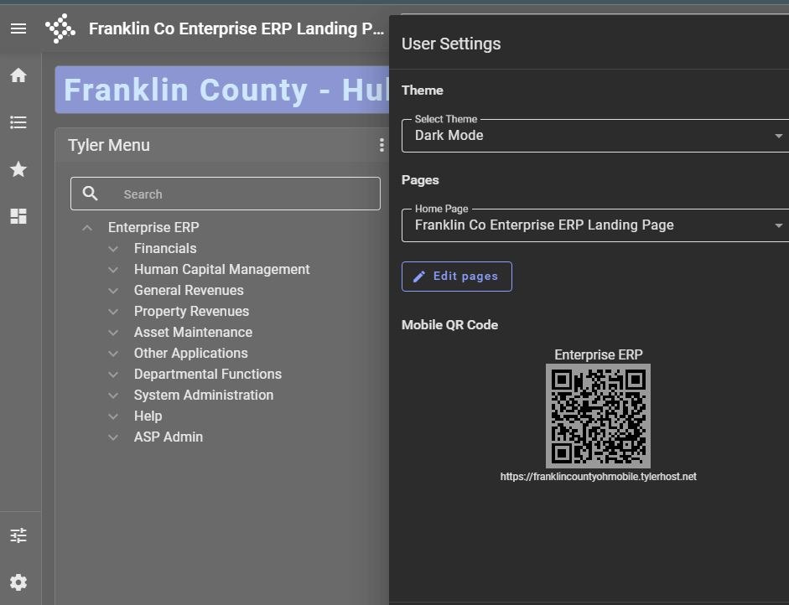
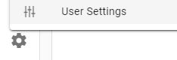
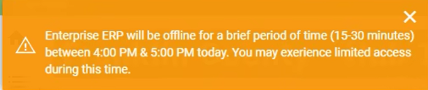
Customize the Hub
Easily change from Light mode (default) to Dark mode
Announcements
Easily change from Light mode (default) to Dark mode
Notes:
Hub can be customized to go in dark mode using the gear icon and ‘User Settings’ Additionally, users can add cards to their landing page. Cards give the ability to drill down to a quick view of data that the user works with. The vendor has built-in cards to use as templates, your mileage may vary.

Slide 7
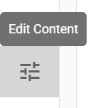
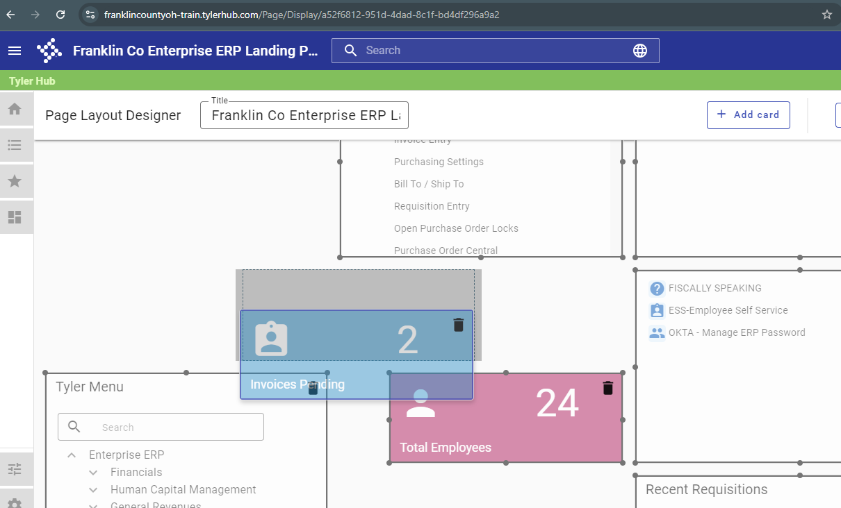
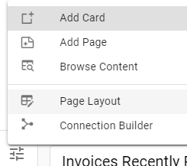
Edit Content button can be used to resize, move, add or delete content on the Hub page
Notes:
Cards can contain data,

Slide 8
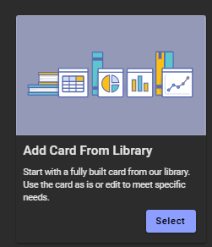
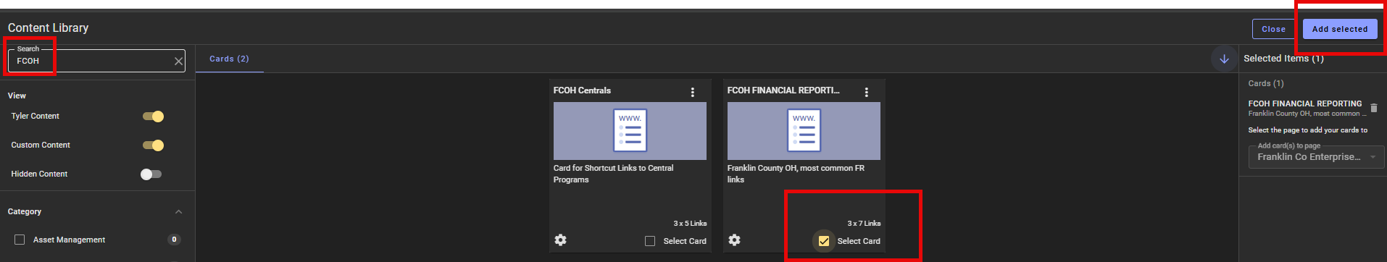
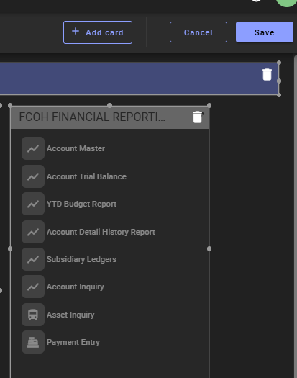
Adding Financial Reporting to HUB page
From left sidebar menu, select Edit Content
Select Add Card
Select Add Card From Library
In Top left search bar enter FCOH
FCOH FINANCIAL REPORTING card appears →Select Card
Select Add Selected in top right
Leave location as is or adjust
Select Save
Notes:
Cards can contain data,

Slide 9
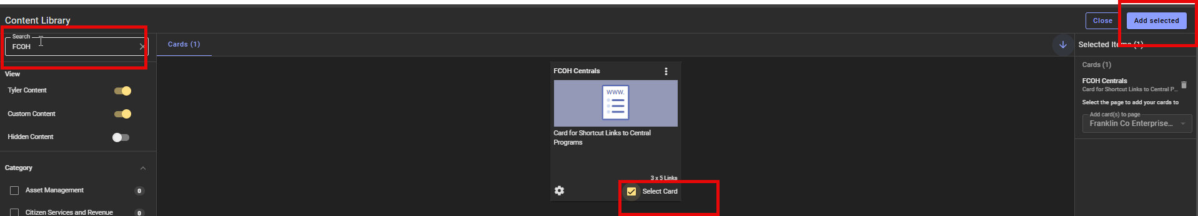
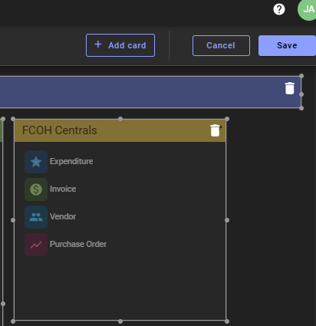
Adding Centrals Card to HUB page
From left sidebar menu, select Edit Content
Select Add Card
Select Add Card From Library
In Top left search bar enter FCOH
FCOH Centrals card appears →Select Card
Select Add Selected in top right
Leave location as is or adjust
Select Save
Notes:
Cards can contain data,

Slide 10
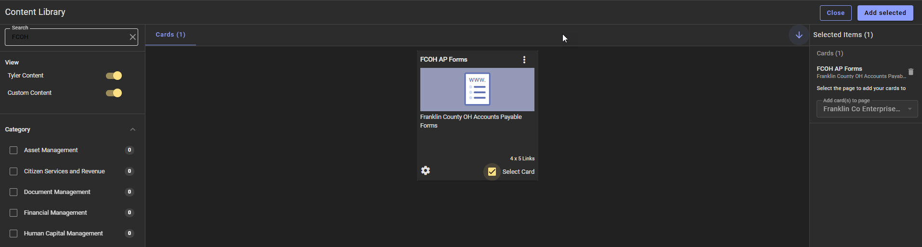
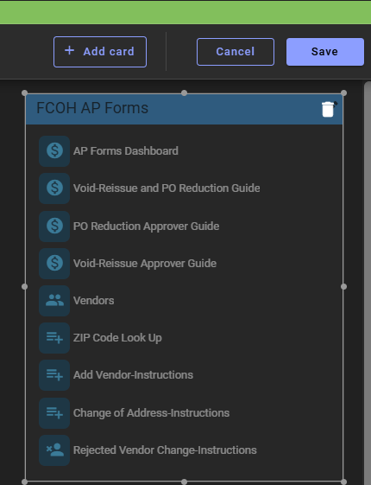
Adding AP forms to HUB page
From left sidebar menu, select Edit Content
Select Add Card
Select Add Card From Library
In Top left search bar enter FCOH
FCOH AP Forms card appears →Select Card
Select Add Selected in top right
Leave location as is or adjust
Select Save
Notes:
Cards can contain data,

Slide 11
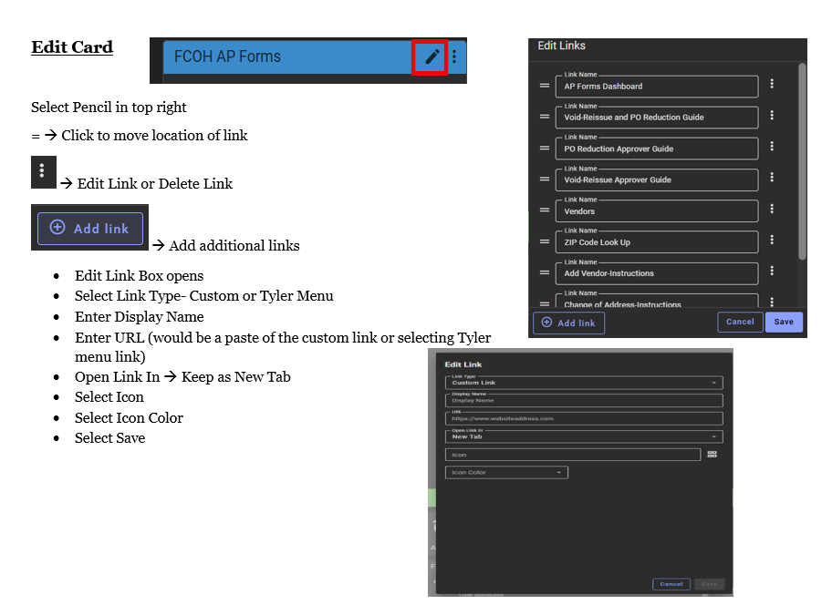
Editing a Card
Notes:
Cards can contain data,

Slide 12
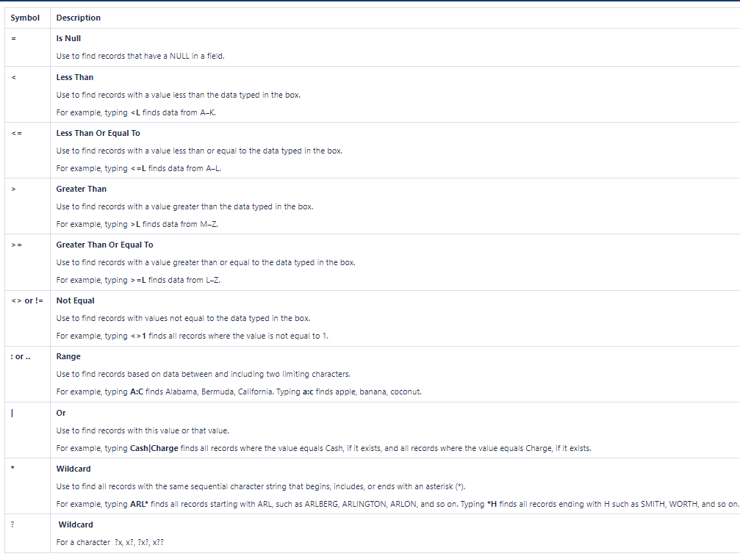
Wildcard Searches
Notes:
Cards can contain data,

Slide 13
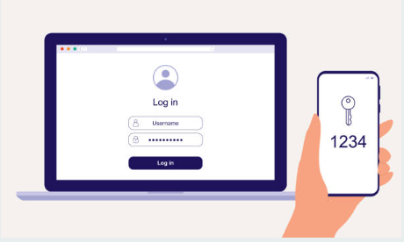
What is Coming?
Multi-Factor

Slide 14

Questions?
ERPSupport@franklincountyohio.gov

