Slide 1

2025 ERP Training

Slide 2

Purchasing Team
Sharon Sabree
Fiscal Support
Lauren Graessle
Assistant Director,
Procurement

Slide 3
Requisition Entry
Deadline for all requisitions to Purchasing is NOON on Tuesdays.
The process begins with a need determined by the Agency.
Requisitions are entered into ERP by the department number, the organization, and the object codes. Once the correct department code is determined, the requisition number is auto-populated.

Slide 4
Once the requisition has been entered into ERP correctly, each agency has an approval path for purposes of checks and balances.
When the approval path is complete, the requisition will be sent to Purchasing.

Slide 5
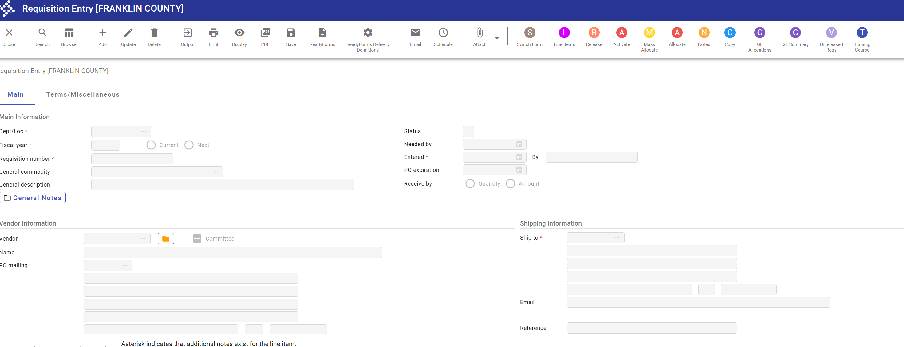

Slide 6
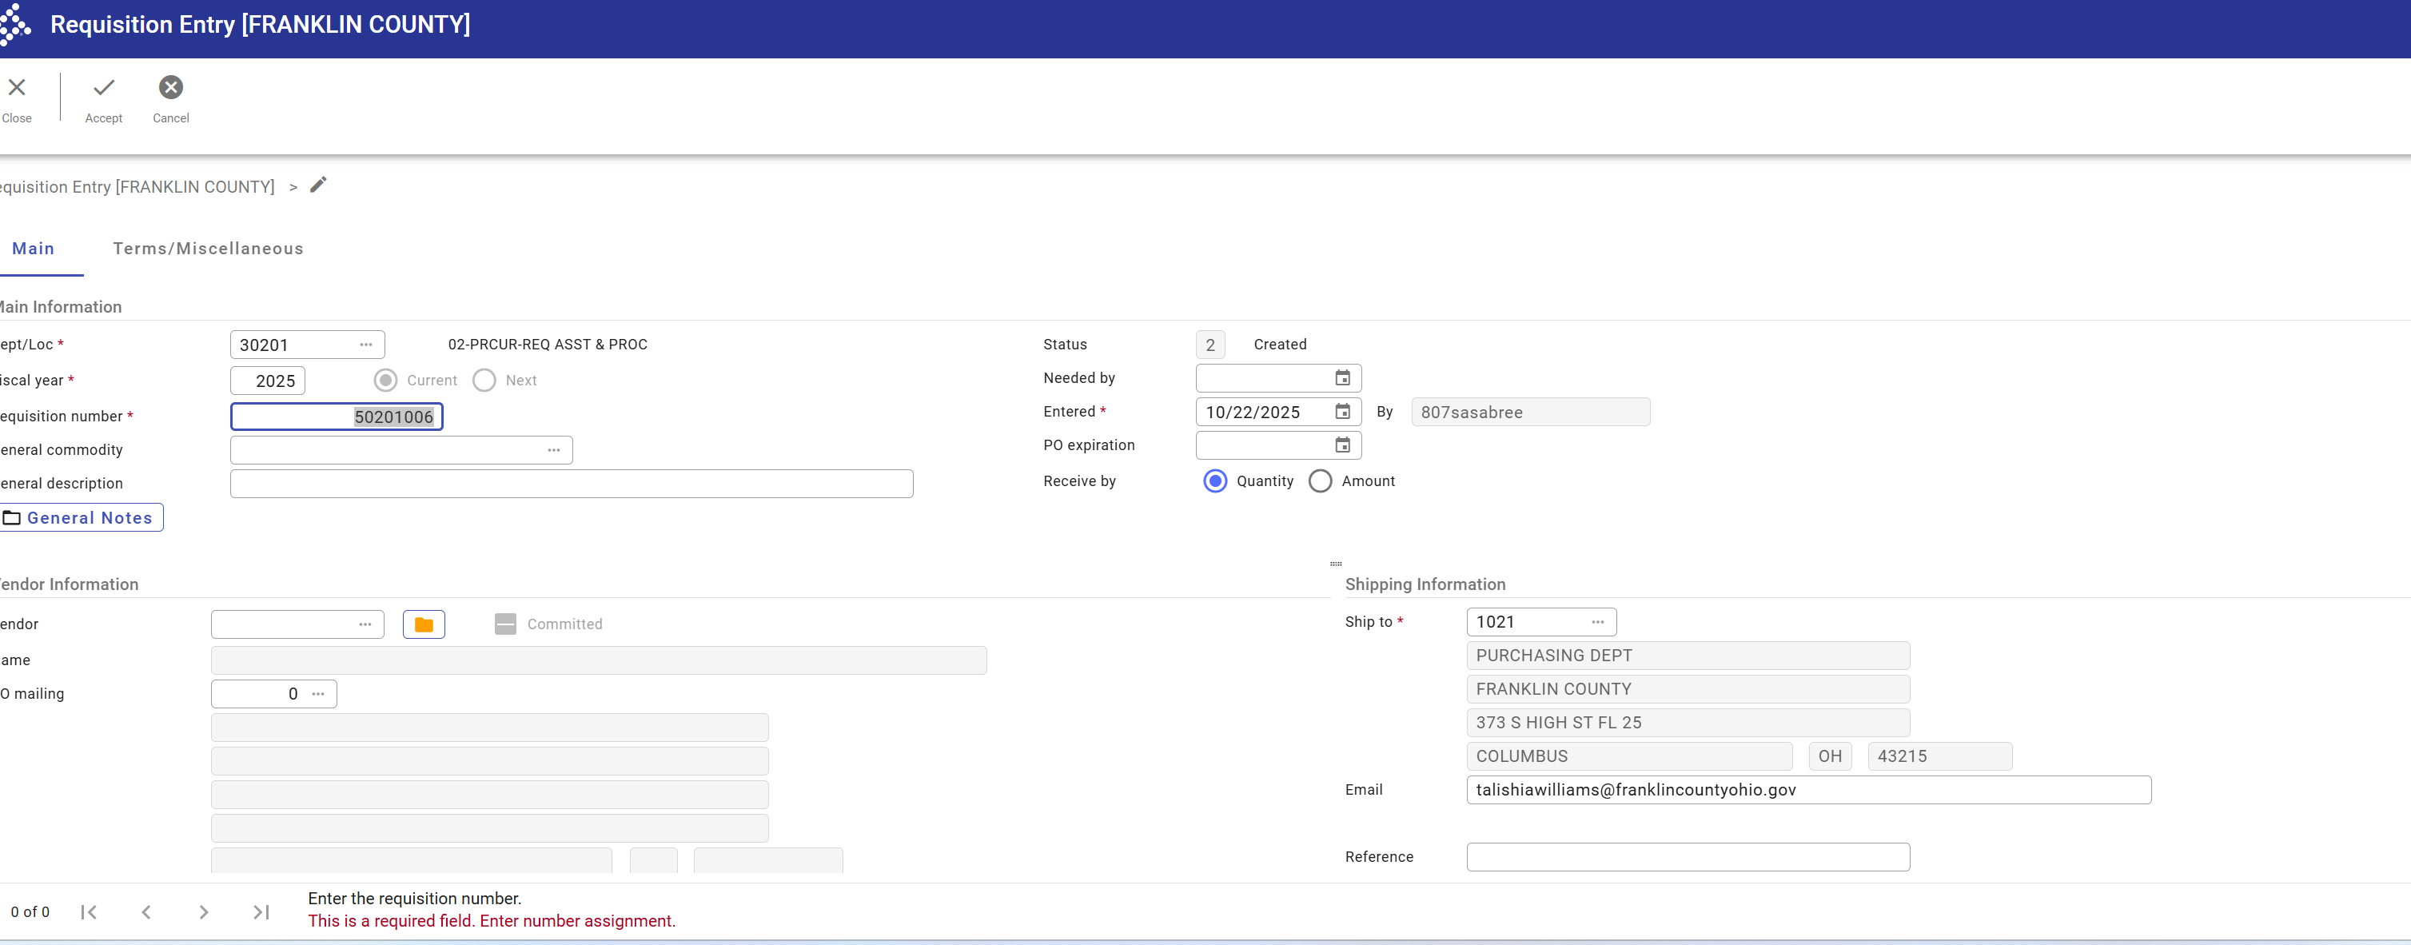


Slide 7
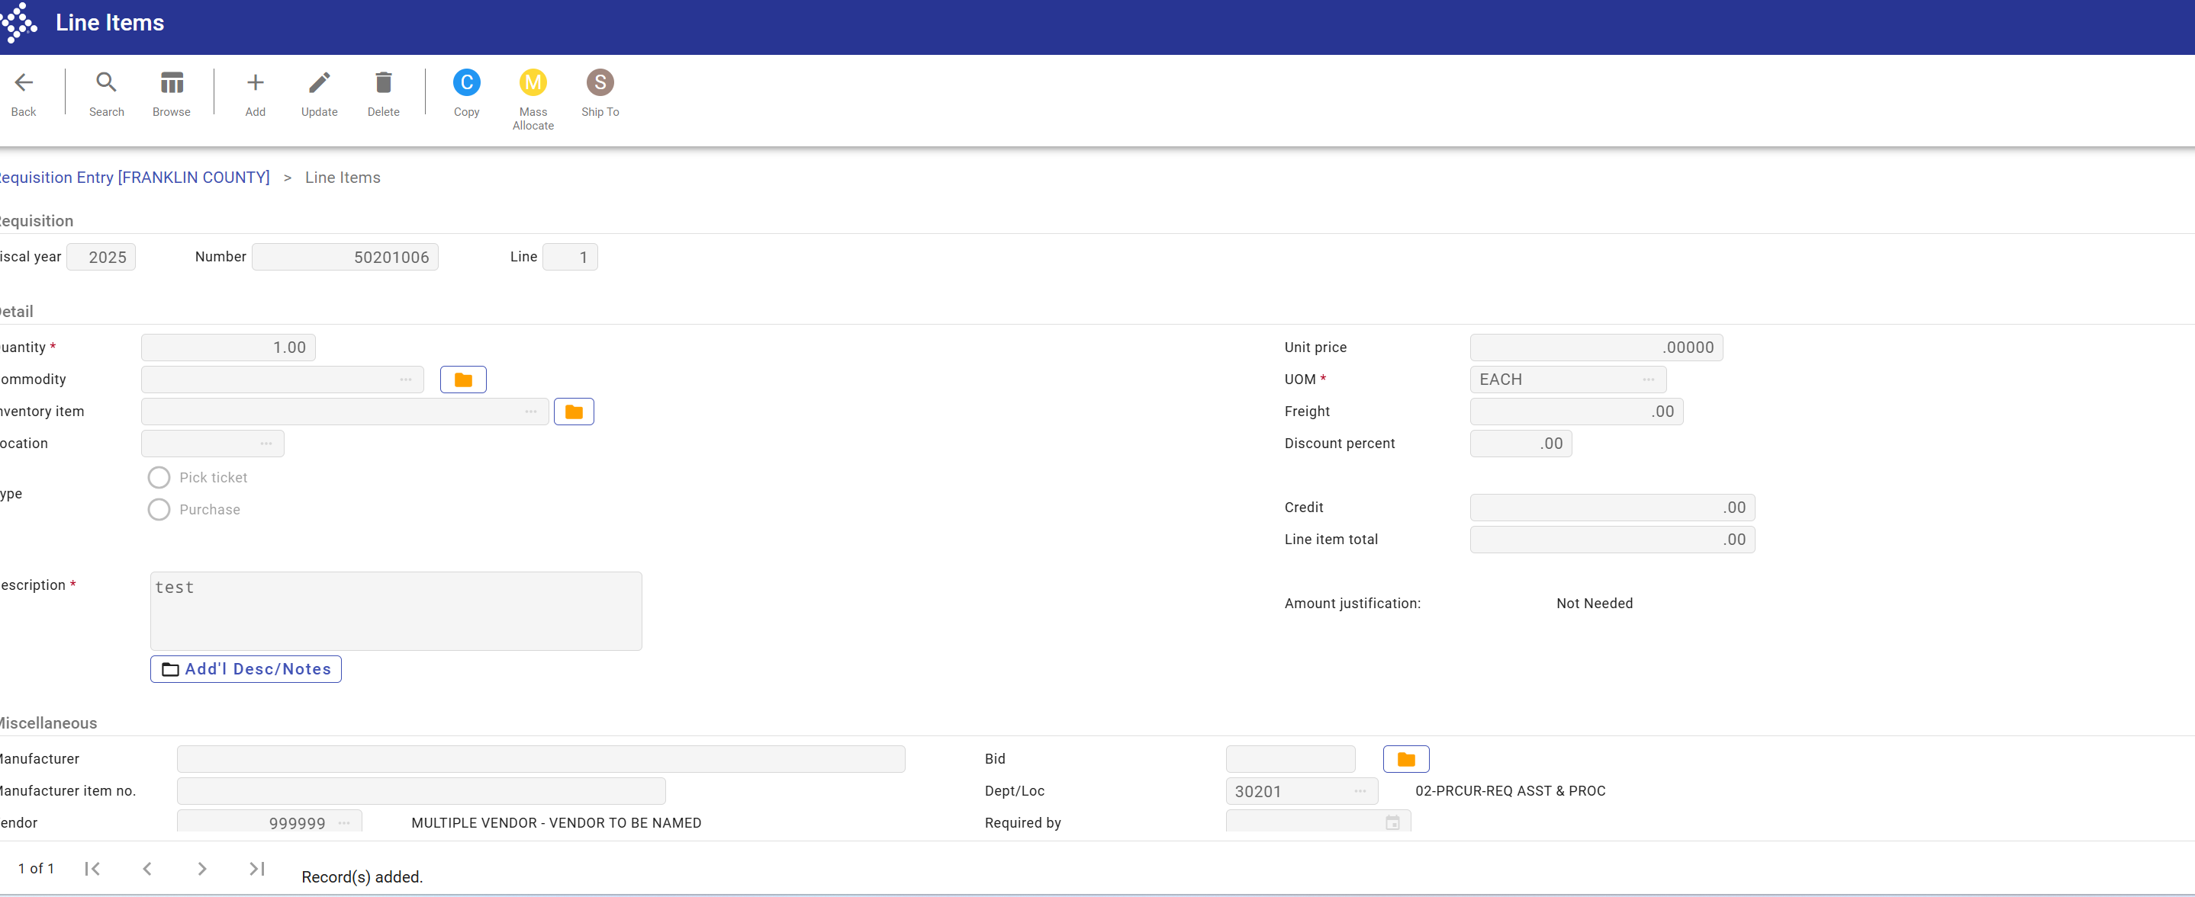

Slide 8
PO ‘s
Once the agency completes the approval process, the requisition is released to the Purchasing Department Requisition Conversion queue, where it is sorted and compliance verified for batching.
When the compliance verification is complete, purchasing will batch the requisition, which will then be converted to a PO for the next General Session agenda.

Slide 9
Contract Resolution
If the requisition is associated with a contract resolution, the agency must designate it as “CON RES” when entering it in ERP.
Purchasing will send the agency a PO Proof List.
The agency must upload the PO proof list with all other contract documents to CRMS by Friday at noon so that it can be added to the next General Session agenda.
Once the resolution is approved by the Board of Commissioners, the Resolution Number should be referenced every time a requisition is entered for this contract.

Slide 10
Administrative Signature ( Admin Sign)
The County Administrator has been granted authority by various resolutions to sign specific contracts.
These POs will be processed and batched by Purchasing following the same process and timeframe as regular POs.
When using this authority, ensure it is properly notated as ADMIN SIGN in ERP, using the same method discussed for “CON RES” designations.
Once an Admin Sign PO is approved under Resolution by the BOC, the agency must submit the contract documents to the Clerk’s Office”

Slide 11
Content Manager
Thank you to all agencies that are utilizing the content manager.
Use of the Content Manager is mandatory as of the second quarter of 2025
The Content Manager should be used to upload all pertinent info that pertains to that requisition (i.e., SOWs, 3 quote info, etc.) and ALL travel information if entering a travel requisition.
2026 Requisition Guidelines will have instructions on uploading information to the Content Manager

Slide 12
Process for Rejecting and Deleting PO’s
The Purchasing department has a compliance team that reviews all PO's.
In review, the team will be looking for:
Reference of CON RES POs
Administrative Signature
Resolution numbers
Cooperative contract references
Data Board Numbers
Professional Services being referenced correctly
Service PO's and Risk Assessment

Slide 13
Incomplete information could result in Purchasing rejecting and/or deleting requisitions, which could delay the process of Procurement for the Agency.​
Agencies will be notified in such instances.

Slide 14
Franklin County Board of Commissioners
Purchasing Department
373 South High Street, 25th Floor
Columbus, Ohio 43215-6315
Phone: 614-525-3750
Email: Procurement@franklincountyohio.gov
Website: http://Purchasing.FranklinCountyOhio.gov

